Slide 1
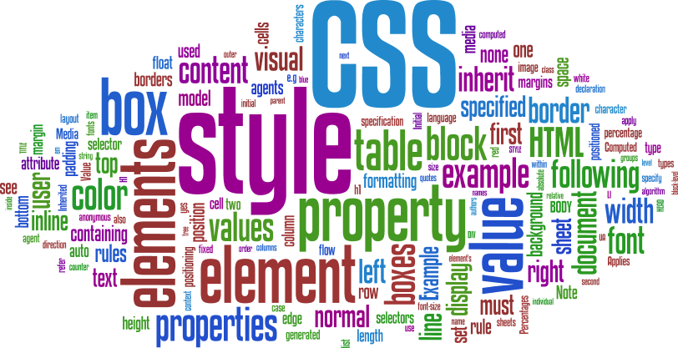

Slide 2
CSS
INTRO
index.html
CSS File
about.html
contact.html
A single Cascading Style Sheet file can control the color typography and layout of multiple web pages

Slide 3
CSS
“CASCADING”
Browser Defaults
Embedded Styles
Inline Styles
External (Imported) Styles
Contained in the body of HTML page
Contained in the <head> section of the HTML page
“style” attribute
Separate text file with .css extension
<style> element
Applies only to the specific element
<link> element in the head section provides the URI to the .css file.
Applied to the entire web page

Slide 4

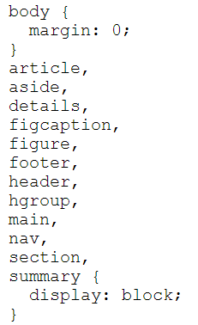
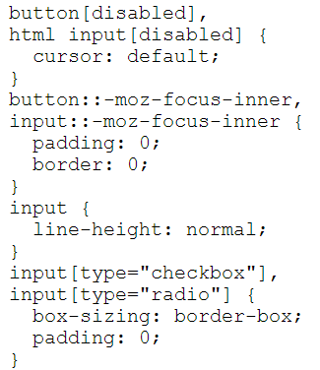
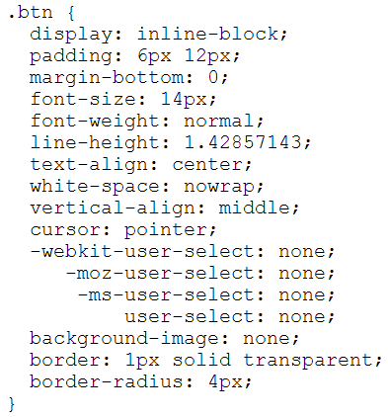
CSS
SYNTAX
SELECTOR
HTML Element Name (just name)
Class Name (“.” + name)
Id Name (“#” + name)

Slide 5
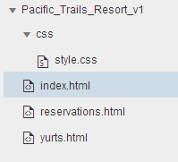
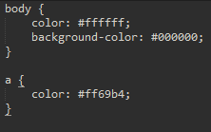
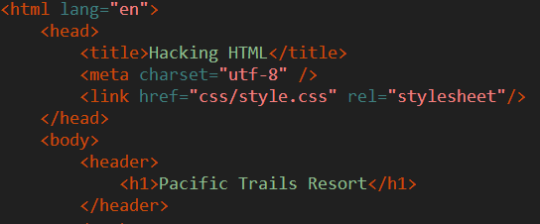
CSS
CSS COLOR
<link href="css/style.css" rel="stylesheet"/>
Change text color to White (#ffffff)
Change Background color to Black (#000000)
Change hyperlink color to Pink(#ff69b4)
Always placed in the header section
TEST
Try using inline/embedded CSS style attribute for the elements!

Slide 6
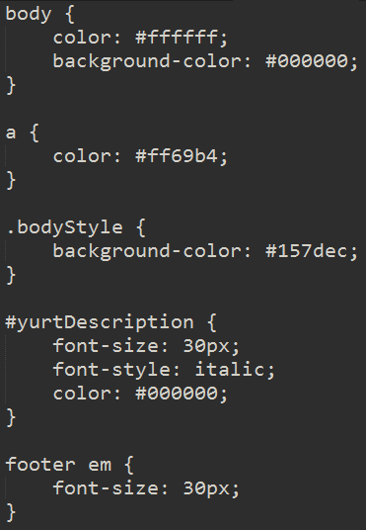
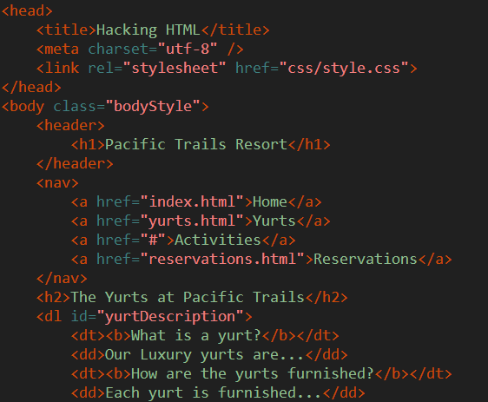
CSS
CLASS / ID SELECTORS
Add Id/Class attributes to elements within yurts.html
“Cascading” witnesses by overriding styles within a css document
Id user more for JS, Class used more for CSS
New font styles introduced
Descendant Selectors – footer > em

Slide 7
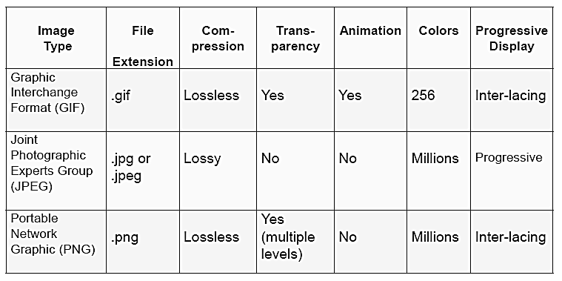
CSS
WEB GRAPHICS

Slide 8
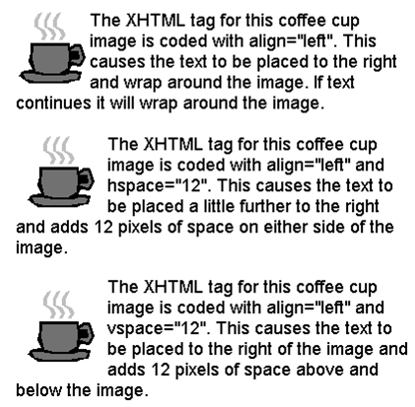
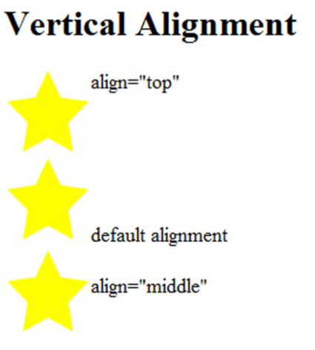
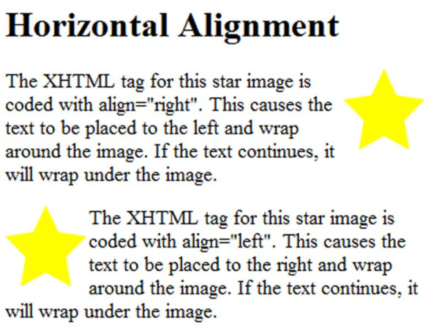
CSS
WEB GRAPHICS
File URI
Height of graphic in pixels
<img src=“cake.png” alt=“birthday cake” height=“100” width=“100”>
Alternate text description (e.g. for disabled people)
Width of graphic in pixels
Align = ?
<img> align attribute
hspace attribute
vspace
attribute

Slide 9
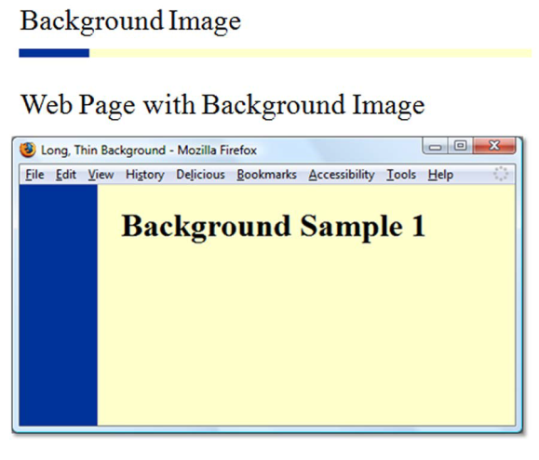
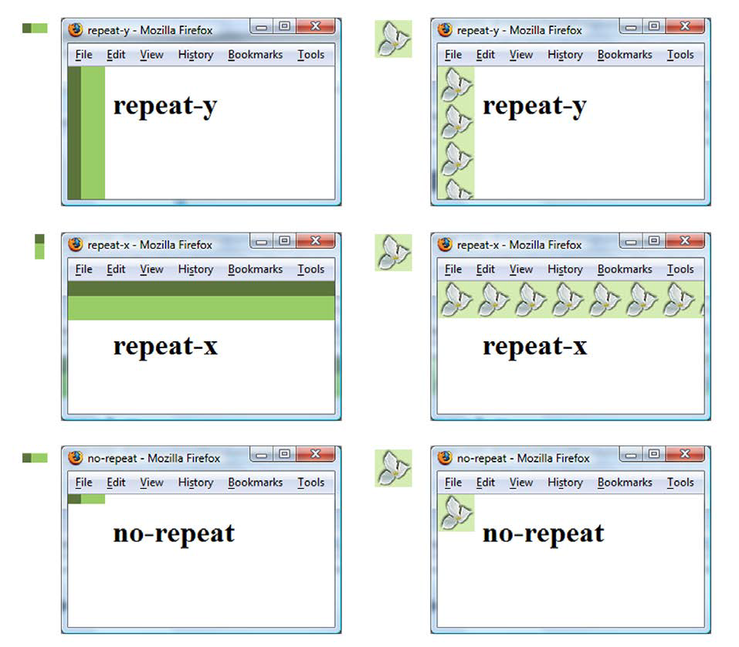
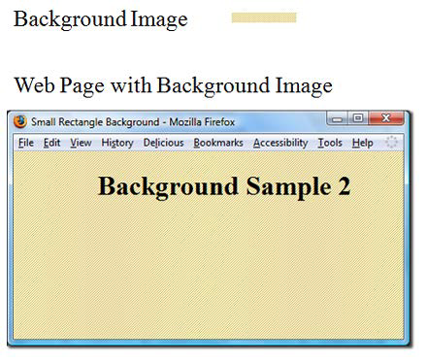
CSS
CSS PROPERTIES - BACKGROUND
body {
background-image: url(background.png);
background-repeat: no-repeat;
}
* By default images tile (repeat)

Slide 10
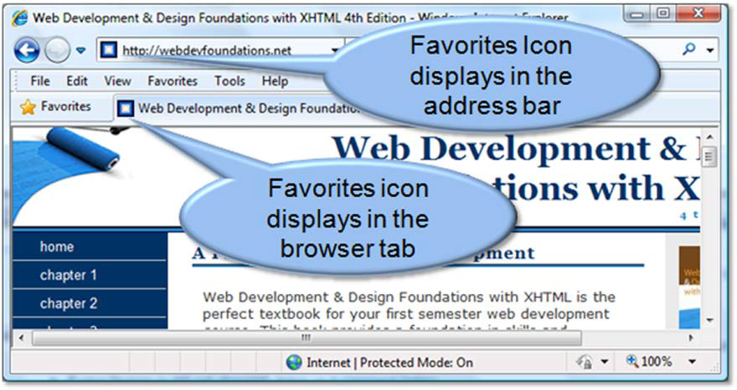
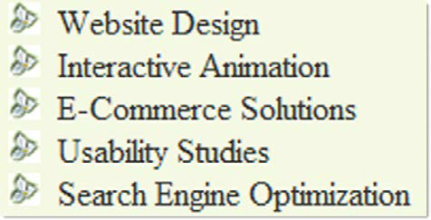
CSS
CSS PROPERTIES -
FAVORITES ICON / LIST MARKERS
ul {
list-style-image: url(flower.png);
}
<link rel="icon" href="favicon.ico" type="image/x-icon" />
* Generally of size 16px x 16px

Slide 11
CSS
CSS FONT PROPERTIES
font-family | Arial | Helvetica | sans-serif (can be other font families. last is the fallback)
font –size | 90% OR 35px (can be given as % or pixels)
font-weight | bold | bolder | light | lighter | normal | inherit | 100-900 (in increments of 100)
font-style | normal | italic | oblique
@font-face | font-family | src (e.g. something like url(webfont.woff))
line-height | normal | 3.5 (relative to element’s font size) | 3em | 34% (relative to element’s font size)
text-align | start | end | left | right | center | justify | match-parent | start end
text-indent | 3mm | 30px | 15% (relative to element’s font size) | each-line | hanging
letter-spacing | normal | initial | inherit | 3mm | 3px
width | auto | inherit | 100% | 200px | 30em
height | auto | inherit | 100% | 200px | 30em
Notes:
@font-face allows you to load web fonts instead of just relying on the system fonts installed on a machine.

Slide 12
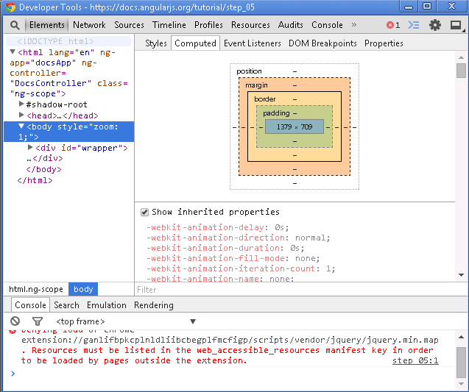
CSS
BOX MODEL
Content
Padding
Border
Margin
Top/Bottom/Left/Right

Slide 13
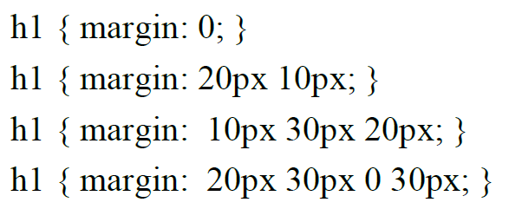
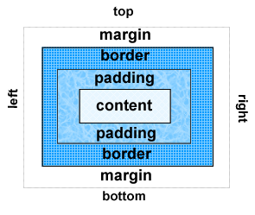
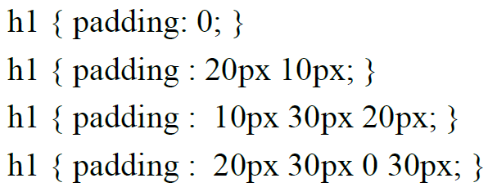
CSS
MARGIN / PADDING
Clockwise property: top right bottom left
Notes:
=

Slide 14

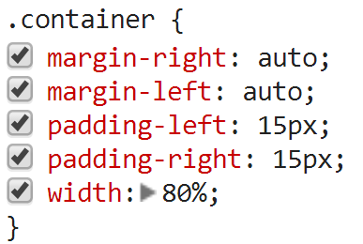
CSS
PAGE CENTERING

Slide 15
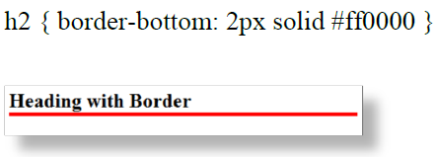
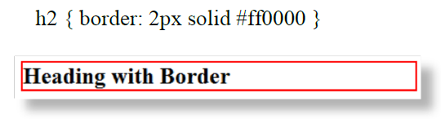

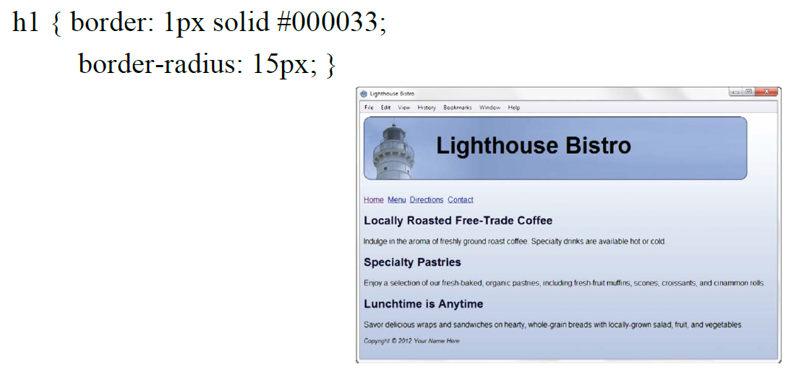
CSS
BORDER

Slide 16
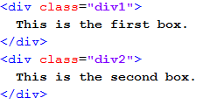
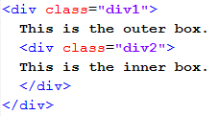
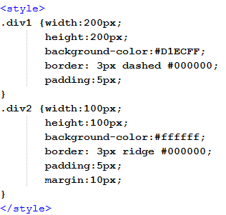
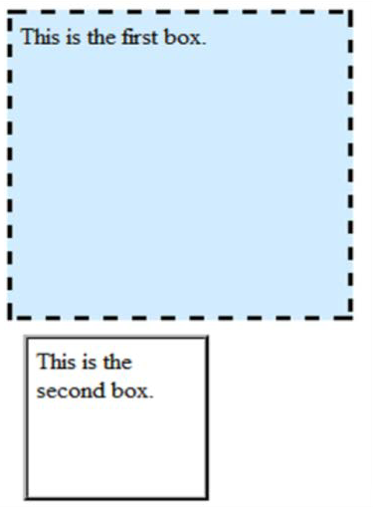
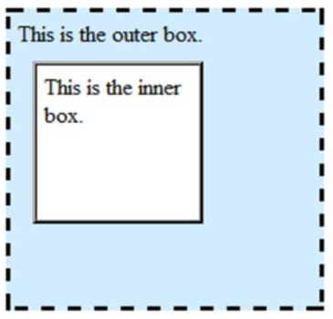
CSS
PAGE LAYOUT (BASIC)

Slide 17
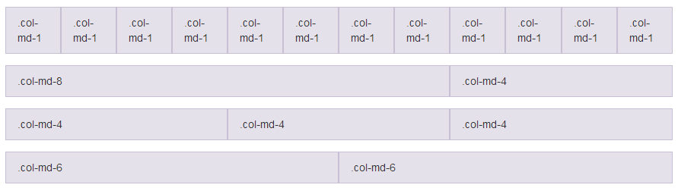
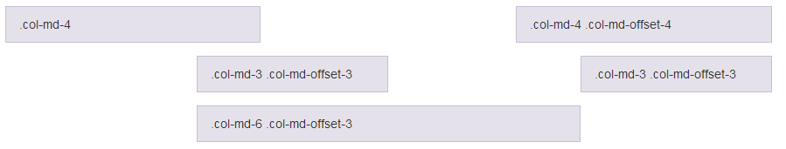


CSS
PAGE LAYOUT (ADVANCED)
GRID LAYOUTS
Bootstrap
Foundation
NON-GRID LAYOUTS
D3.js

Slide 18
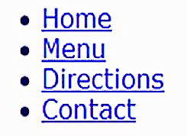

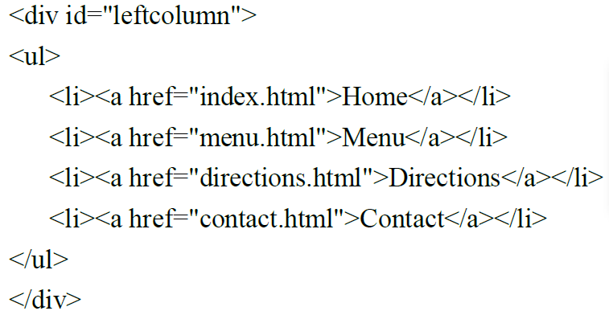
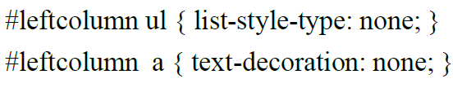


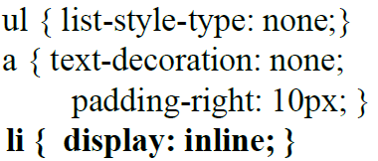
CSS
NAVIGATION
Remove list dots and text underline

